Slide 1
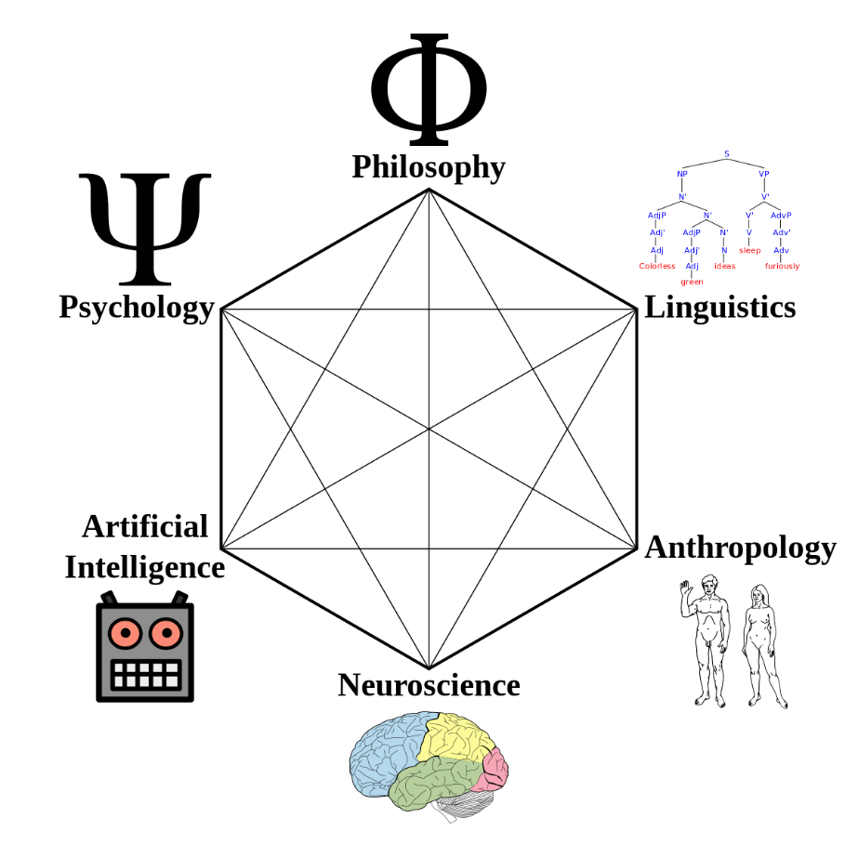
Bachelor Thesis Introduction –
Effect of stimulus duration on Event-related potentials during a rapid serial presentation task

Slide 2



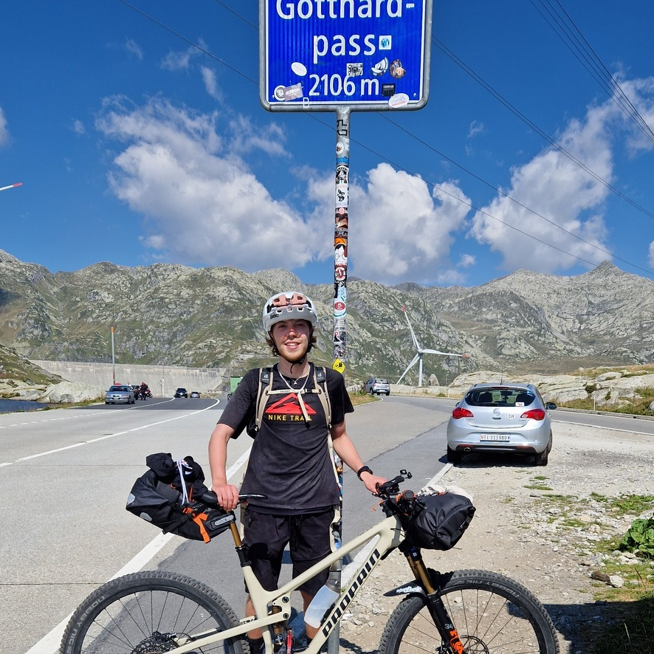
About me
Jan Sauter, 26 years old, study Data Science B.Sc.
From a village (Hossingen) on the Swabian Alb near Balingen
Initially studied Mobile Media B.Sc. at HdM (4 semesters)
Switched to university in 2021 because I enjoyed the theoretical stuff & was fascinated by AI
Hobbies: Cycling, Running, Climbing, Hiking, Guitar
Hohenzollern Castle
Danube valley on Swabian Alb
Me bikepacking

Slide 3
My study program
Data Science B.Sc.
Sub-program of Computer Science
Foundational CS & Mathematics lectures
Specific lectures on data lifecycle (collection, warehousing, analysis, visualization), Artificial Intelligence & Machine Learning
Data Science project with given dataset (public transport data from Zürich)
Exchange semester WS 24/25: National Taiwan University (NTU) in Taipei

Slide 4
Bachelor thesis
Topic: Effect of stimulus duration on Event-related potentials during a rapid serial presentation task
Analyze EEG data collected during study by Martin Geiger, using Unfold.jl
Apply mass-univariate analysis including Deconvolution
Influence of stimulus duration will be assessed using univariate regression (linear and non-linear modeling)

Slide 5
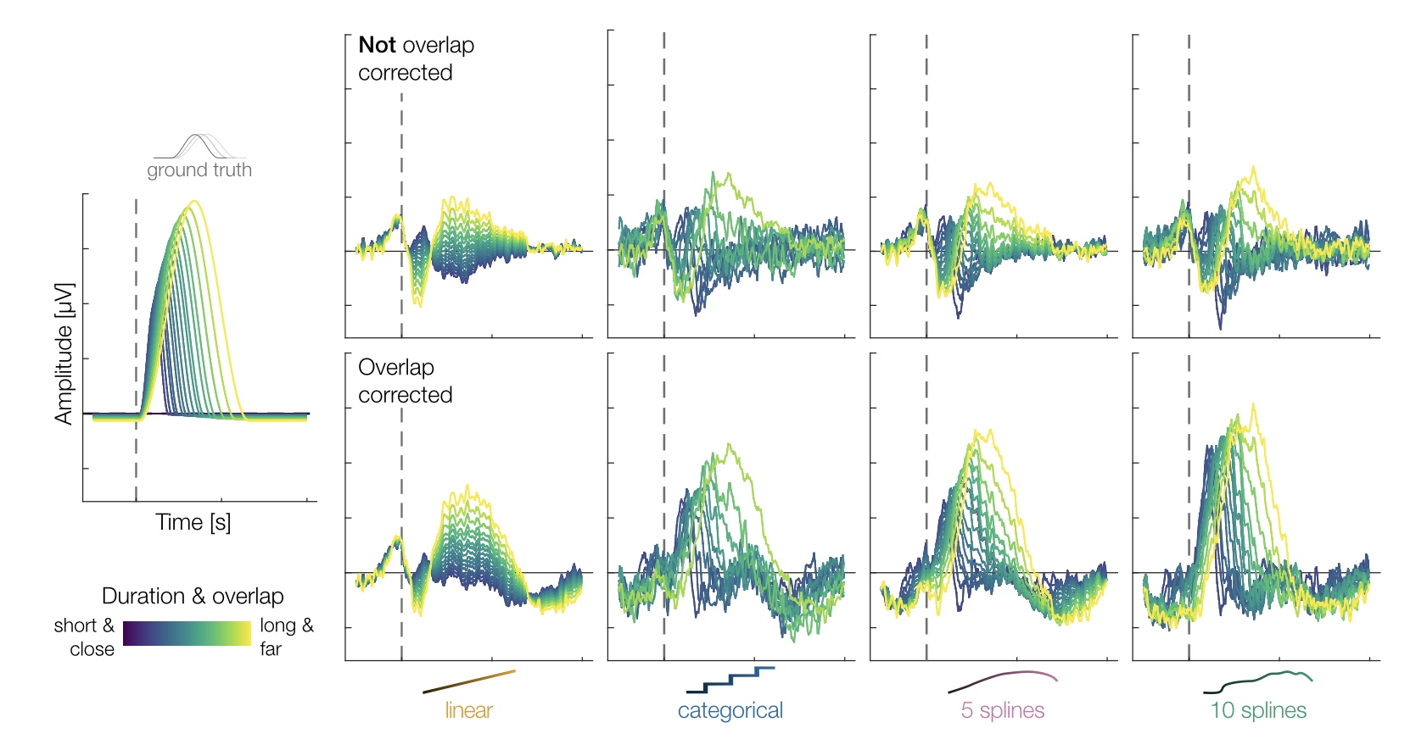
Comparison of duration models
Comparison of duration models with and without overlap correction from the paper ’Brain responses vary in duration - modeling strategies and challenges’ by Skukies et al. CC BY 4.0

Slide 6
Goals of thesis
Scientific Goal: Does the duration for which you see a face influence the brain response on a sub-second scale?
Methodological Goal: Investigate the application of deconvolution-based overlap correction in rapid presentation paradigms
Stretch goals:
Provide a comparison of modelling duration effects non-linearly and linearly
Assess effect of using blanks in a rapid serial presentation scenario (influence of jitter)

Slide 7
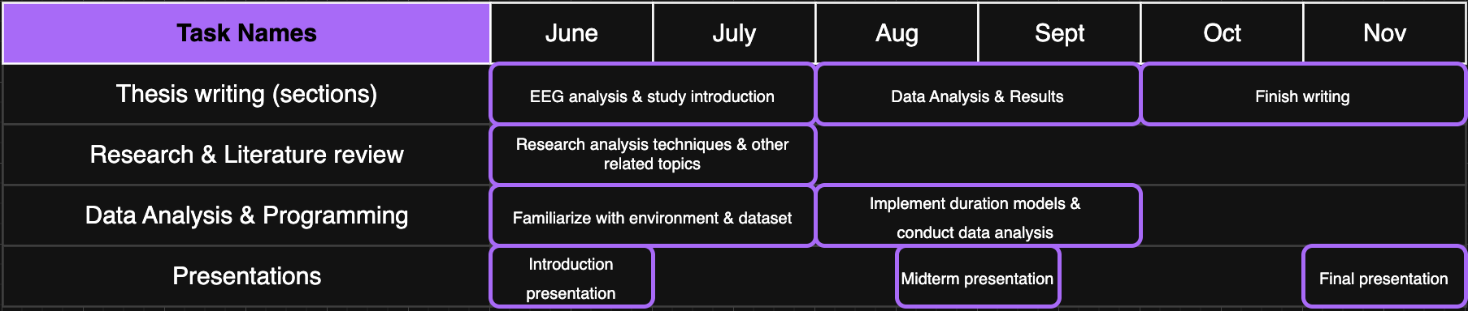
Gant chart

Slide 8
End - Thank You ☺

